Slide 1
HTML and CSS
Lecturer: Meng Duc Bui Tien (Mr.)

Slide 2
Formatting Text with HTML and CSS
<body>
<p>This is <b>bold text</b>.</p>
<p>This is <strong>strongly important text</strong>.</p>
<p>This is <i>italic text</i>.</p>
<p>This is <em>emphasized text</em>.</p>
<p>This is <mark>highlighted text</mark>.</p>
<p>This is <code>computer code</code>.</p>
<p>This is <small>smaller text</small>.</p>
<p>This is <sub>subscript</sub> and <sup>superscript</sup> text.</p>
<p>This is <del>deleted text</del>.</p>
<p>This is <ins>inserted text</ins>.</p>
</body>

Slide 3
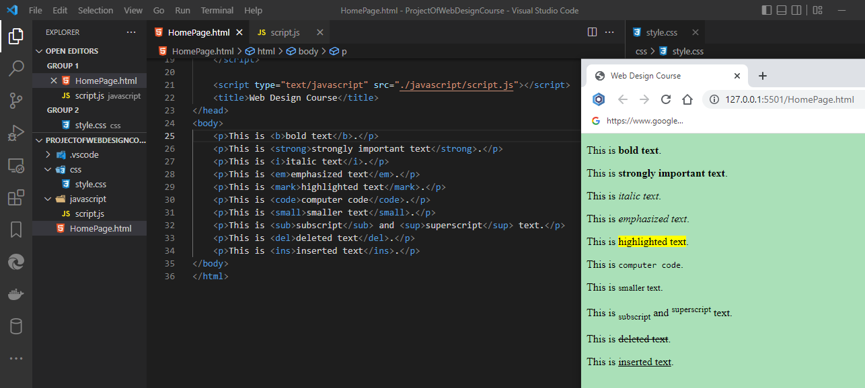
Formatting Text with HTML and CSS
<body>
<p>This is <b>bold text</b>.</p>
<p>This is <strong>strongly important text</strong>.</p>
<p>This is <i>italic text</i>.</p>
<p>This is <em>emphasized text</em>.</p>
<p>This is <mark>highlighted text</mark>.</p>
<p>This is <code>computer code</code>.</p>
<p>This is <small>smaller text</small>.</p>
<p>This is <sub>subscript</sub> and <sup>superscript</sup> text.</p>
<p>This is <del>deleted text</del>.</p>
<p>This is <ins>inserted text</ins>.</p>
</body>

Slide 4
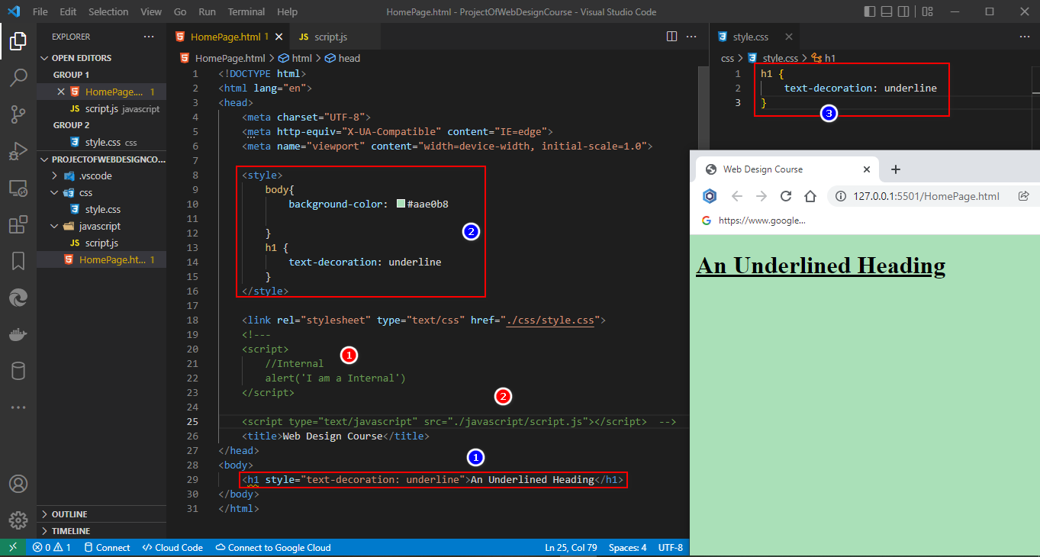
Character Formatting Using CSS

Slide 5
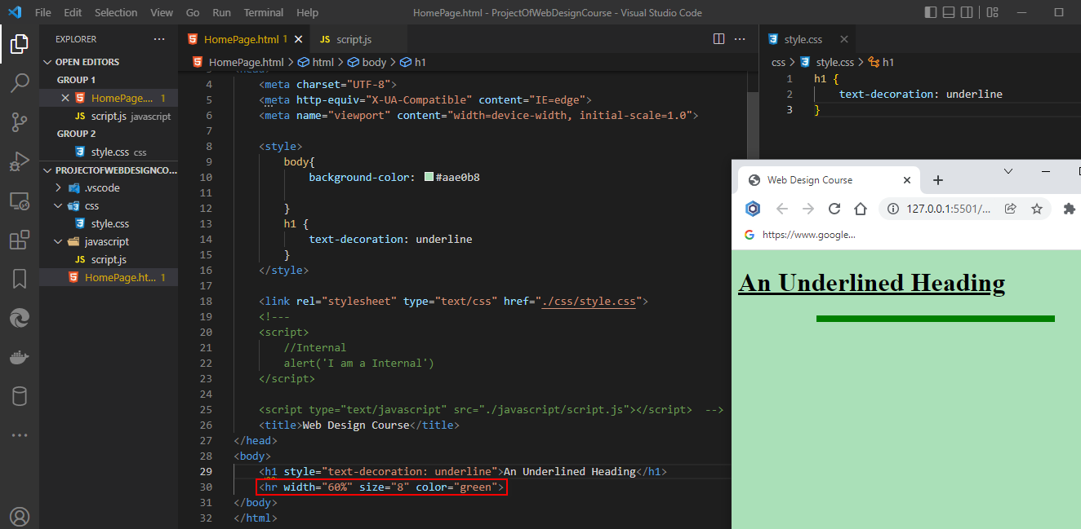
Style HR (Horizontal Ruler/Line)

Slide 6
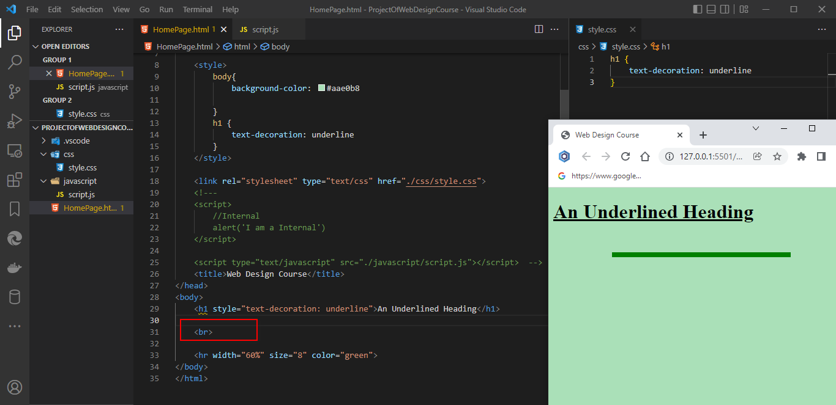
Line Break
The <br> tag breaks a line of text at the point where it appears

Slide 7
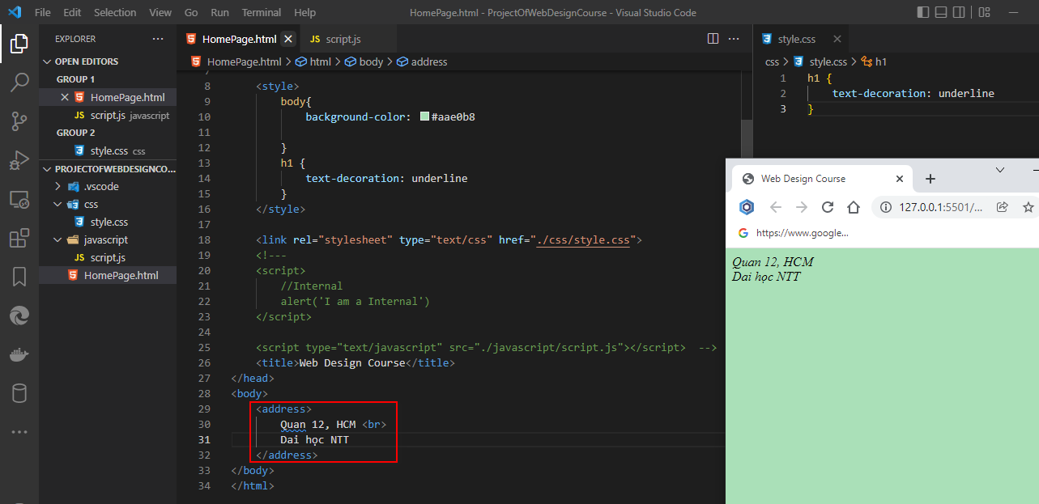
Addresses
The <br> tag breaks a line of text at the point where it appears

Slide 8
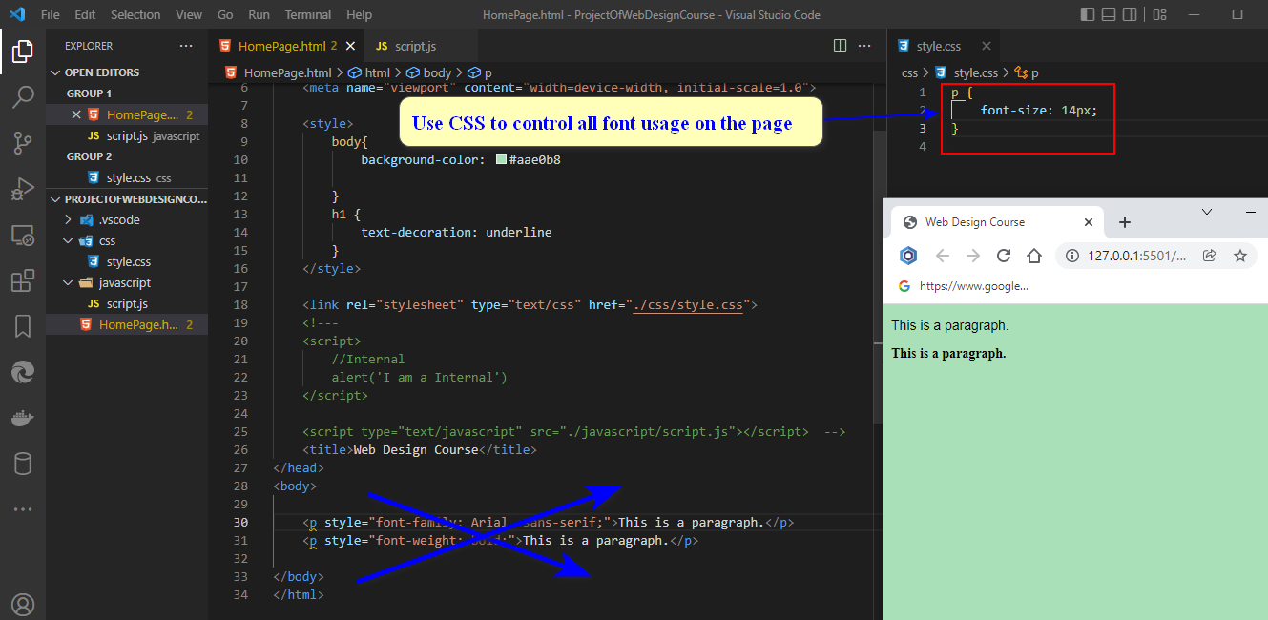
Fonts and Font Sizes
Use CSS to control all font usage on the page

Slide 9


Slide 10
